Slide 1
Factors of Test Anxiety and Its Prediction Model
Group member: Jingyuan Liang, Zhen Yan, Siyu Lin, Ming Chen, Wenjie Tang
HUDK 4050: Core Methods in Educational Data Mining

Slide 2
Content
Background introduction
Data collection
Data analysis
Discussion

Slide 3
Background
The level of their psychological distress rises steadily.
Self-efficacy
Personal Traits
Academic resilience
Procrastination
Potential Factors
Perceived test difficulty
Exam-related Factors
Previous tests ranking
the amount of average time of reviewing per day

Slide 4
Problem:
How do different factors affect students’ test anxiety during the final weeks?
How should teachers detect and deal with the severe anxiety?
Reveal the influence of different factors and build a prediction model

Slide 5
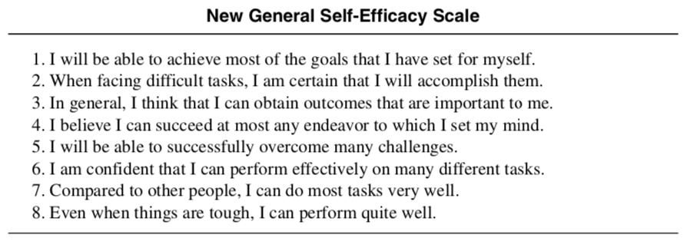
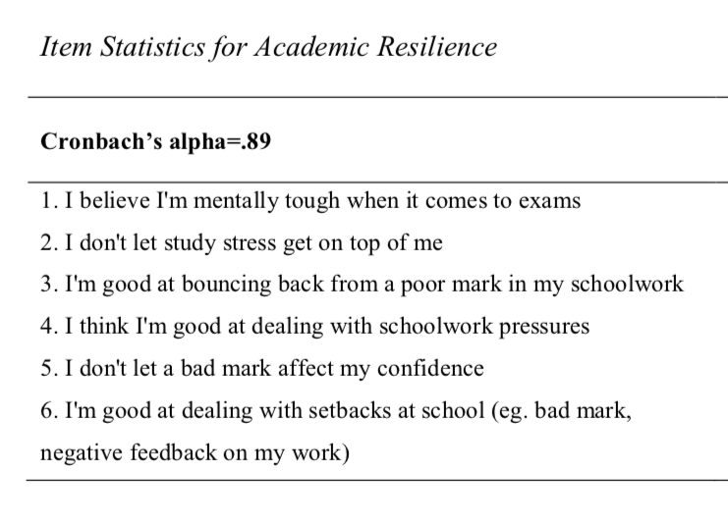
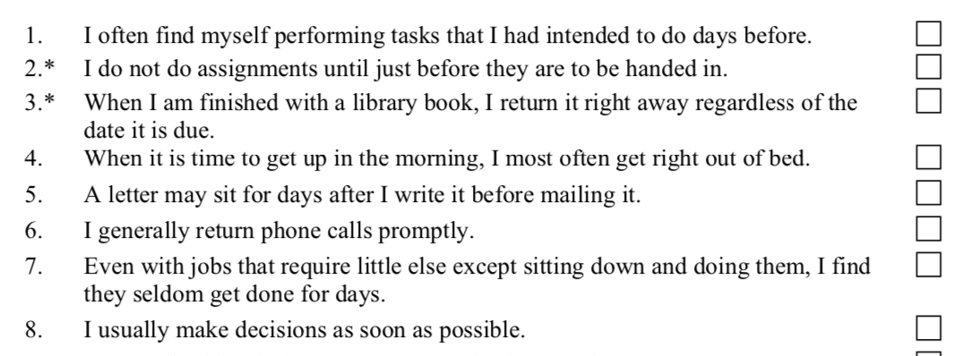
Data collection
Participants 300 students in Columbia University
Procedure Online questionnaire, 1 week before final
Materials
Personal traits
Self-efficacy: New General Self-Efficacy Scale (NGSE)
Academic resilience (Martin & Marsh, 2006)
Procrastination: Procrastination Scale (Lay, 1986)

Slide 6
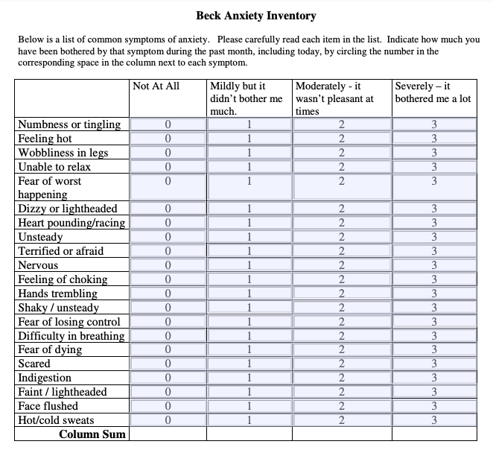
Data collection
Test-related questions
Types: exam/essay/presentation/ integration
Form: individual / group work
Perceived test difficulty
Previous ranking
Reviewing time
Anxiety：Beck Anxiety Inventory (BAI)
0–7: Minimal
8-15: Mild
16-25: Moderate
26-63: Severe

Slide 7

Data analysis
Basic data cleaning
Variable processing
Data preparation
Analysis process
Descriptive statistics
Correlation analysis
Multiple regression
Classifier model

Slide 8
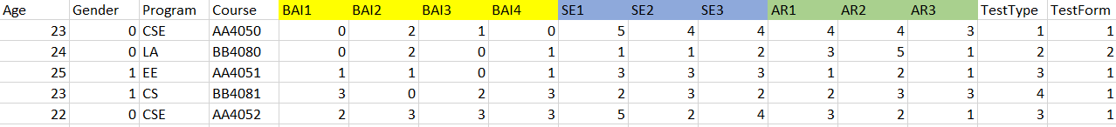


Data analysis
Data preparation
Find missing values
Calculate the scores for different scales
3. Transform categorical variables

Slide 9
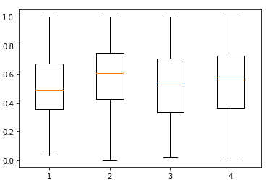
Data analysis
Analysis process
Descriptive Statistics
Take an overview of basic information
Gender
Age
Course
Program
Frequencies of test types
Average scores
Depict boxplots to find outliers

Slide 10
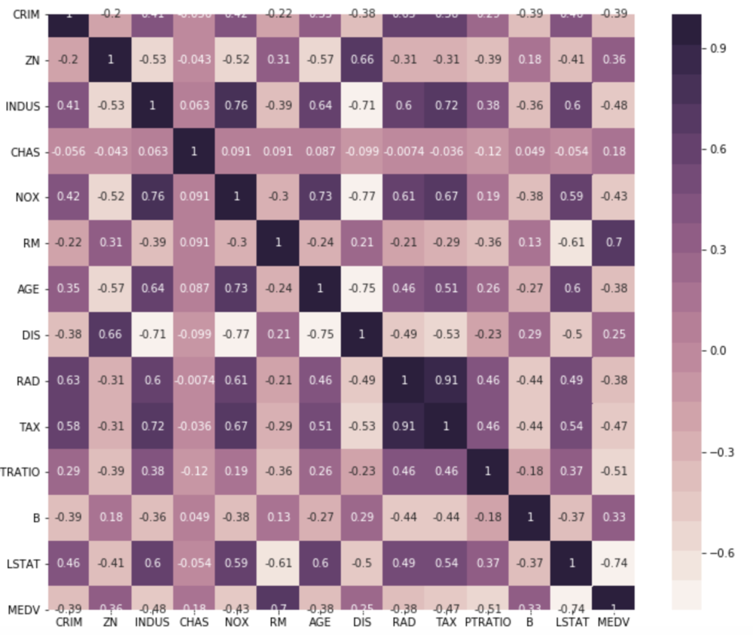
Data analysis
Analysis process
Correlation Exploration
Exclude
Program
Course number
Set a threshold to drop variables with low coefficients.

Slide 11
Data analysis
Analysis process
Multiple Regression
Include variables selected by correlation
Self-efficacy score
Academic resilience score
……
2. Reveal the influence of variables combined to predict anxiety score.

Slide 12
Data analysis
Analysis process
Classifier Model
Transform the BAI score
According to research on the scale:
Score ≥ 26
Score < 26
3. K-fold cross validation
Evaluate the accuracy of models
Select the most successful prediction model
1 = students with severe anxiety
0 = students with no severe anxiety
2. Fit in different models
LogisticRegression/DecisionTree/Naive Bayes

Slide 13
Discussion
results expectation
Positive relationship with anxiety
Self-efficacy
procrastination
perceived test difficulty
average time of reviewing per day
Academic resilience
Previous tests ranking
Negative relationship with anxiety

Slide 14
Discussion
potential limitations
other possible variables
restricted region
accuracy of measures

Slide 15
Implications
Considering our regression results...
Personal Traits (self-efficacy, academic resilience, and procrastination)
Notify assignments and tests in advance
Encouraging feedback (Show successful example)
Group activity & Assignment
Exam related factors (perceived test difficulty, previous tests ranking, and the amount of average time of reviewing per day)
Adjust test types based on result and students feedback

Slide 16
Thank You!

Slide 17
References
A T, Beck, Epstein, Brown, R A, & Steer. (1988). An inventory for measuring clinical anxiety: psychometric properties. Journal of consulting and clinical psychology.
Chen, G. , Gully, S. M. , & D Eden. (2001). Validation of a new general self-efficacy scale. Organizational Research Methods, 4(1), 62-83.
Hong, E. , & Karstensson, L. . (2002). Antecedents of state test anxiety. Contemporary Educational Psychology, 27(2), 348-367.
Martin, A. J. , & Marsh, H. W. . (2006). Academic resilience and its psychological and educational correlates: a construct validity approach. Psychology in the Schools, 43(3), 267-281.
Hong, Eunsook & Karstensson, Lewis. (2002). Antecedents of State Test Anxiety. Contemporary Educational Psychology. 27. 348-367.
Bolbolian, Asgari, S., Sefidi, F., & Zadeh, A. (2021). The relationship between test anxiety and academic procrastination among the dental students. Journal of Education and Health Promotion, 10(1), 67–67. https://doi.org/10.4103/jehp.jehp_867_20n

